Slide 1

Case Study Two
Austin Webb
July 30, 2022

Slide 2
Goals and Objectives
We have been tasked with building and analyzing models that predict employee attrition and monthly income.

Slide 3
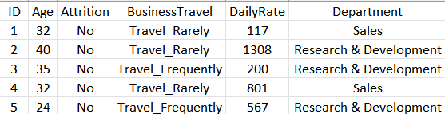
What is the Data
Case Study Dataset:
870 observations and 36 features
It includes features on employees: Age, Department, Job Level, Monthly Income, etc.

Slide 4
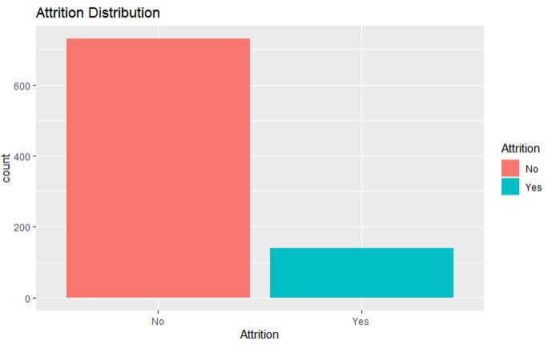
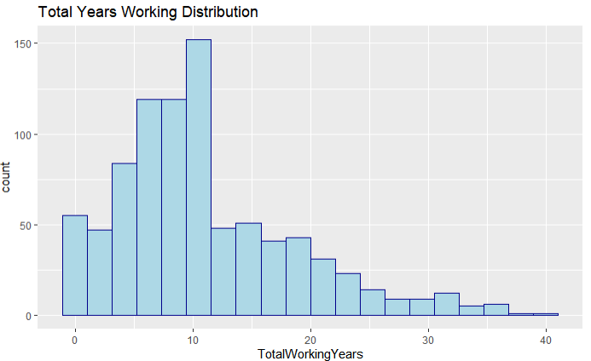
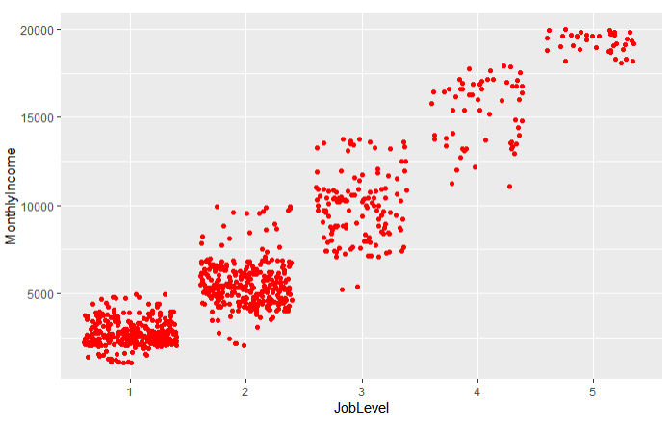
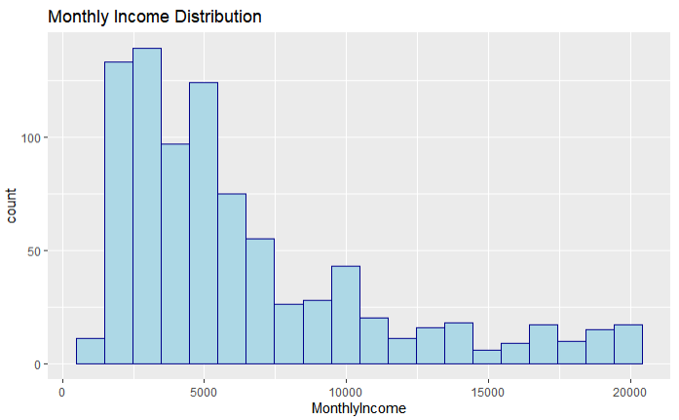
Exploratory Data Analysis

Slide 5
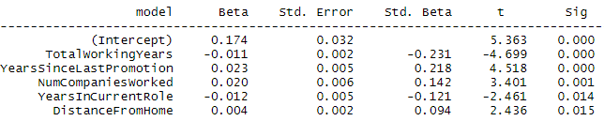
Attrition – Top Five Predictors
Linear Regression Model – Forward Selection
Top Five Predictors
TotalWorkingYears
YearsSinceLastPromotion
NumCompaniesWorked
YearsInCurrentRole
DistanceFromHome

Slide 6
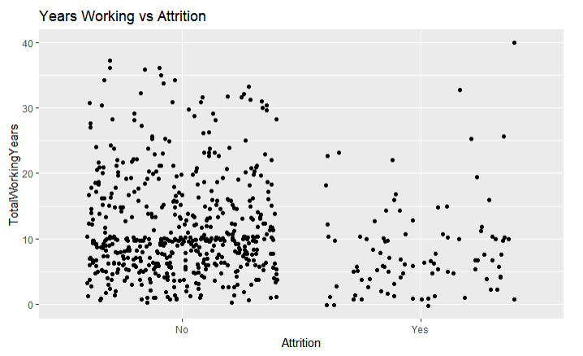
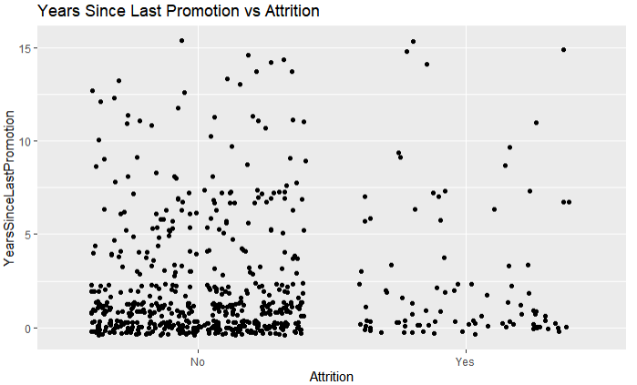
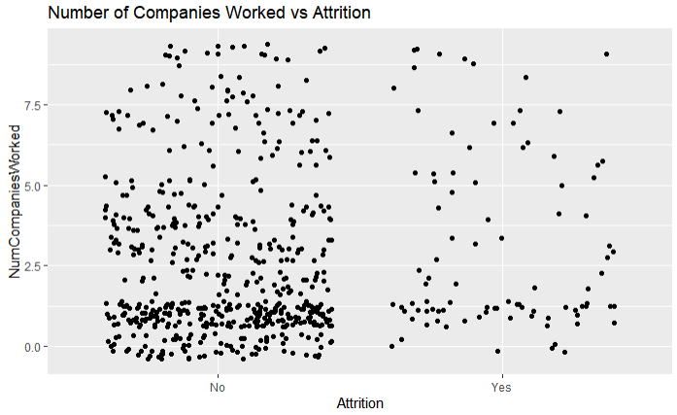
Attrition Plots

Slide 7
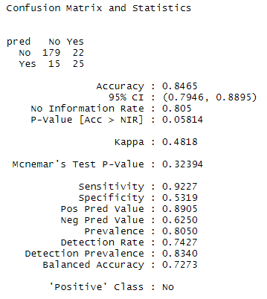
Models for Attrition
Naïve Bayes Model outperformed the kNN Model
Accuracy: 85%
Sensitivity: 92%
Specificity: 53%

Slide 8
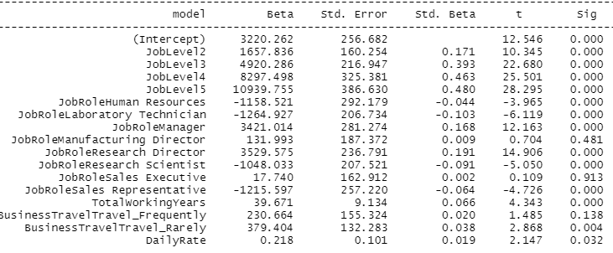
Salary – Top Five Predictors
Linear Regression Model – Forward Selection
Top Five Predictors:
JobLevel
JobRole
TotalWorkingYears
BusinessTravel
DailyRate

Slide 9
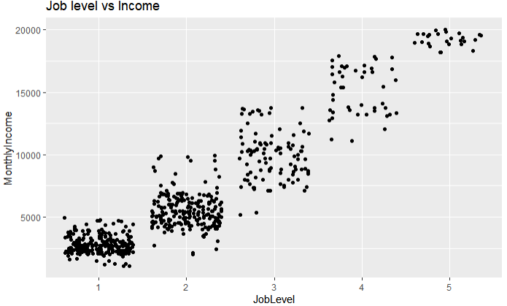
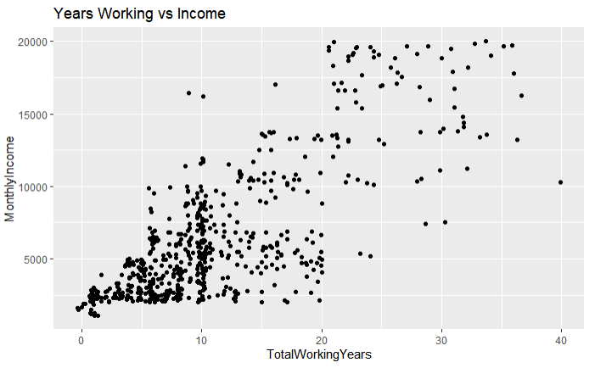
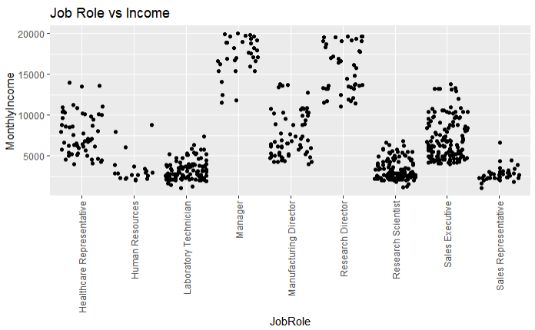
Monthly Income Plots

Slide 10
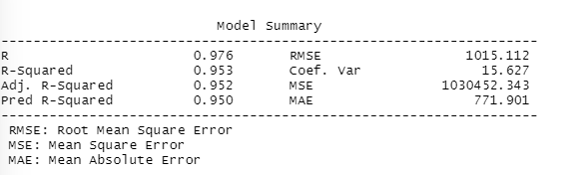
Models for Salary
The best model was a Linear Regression Model that utilized Forward Selection techniques
RMSE ~ $1,000
Adjusted R-Squared = 0.952

Slide 11
Conclusion & Summary
We were able to accurately predict attrition 85% as well as bring the RMSE for Monthly Income down to approximately $1,000.
Final Models:
Attrition: Naïve Bayes Model
Monthly Income: Multiple Linear Regression

Slide 12
Contact Info
Austin Webb
austinwebb@mail.smu.edu

